Slide 1




Slide 2
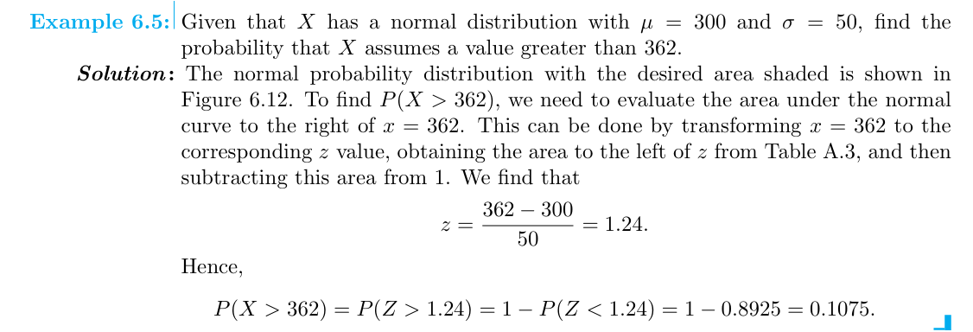

Slide 3
Feature Engineering
Standardization: Transforming data to a standard normal distribution (z-scores) improves performance in algorithms sensitive to feature scales.
Log-Transformations: Used to make skewed data more normally distributed for better interpretability and model performance.

Slide 4
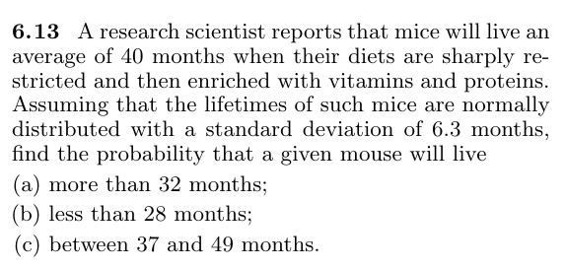

Slide 5
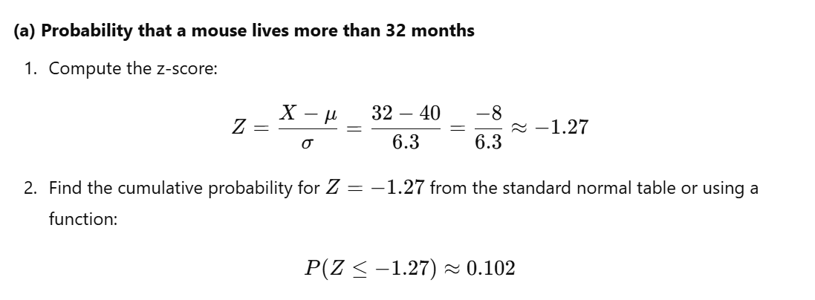


Slide 6
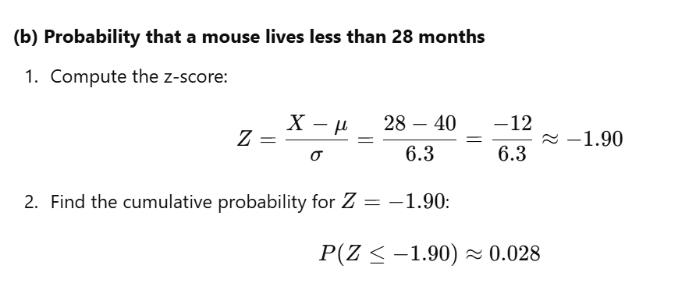


Slide 7
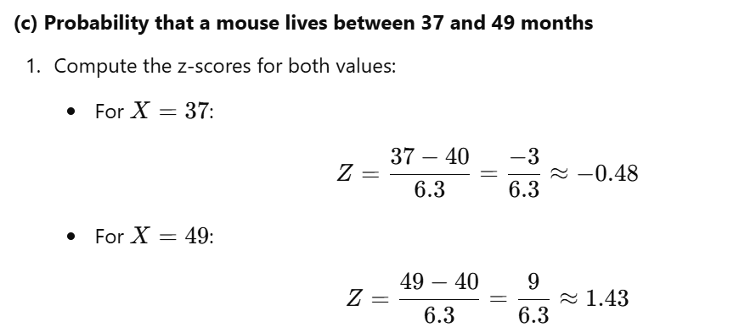
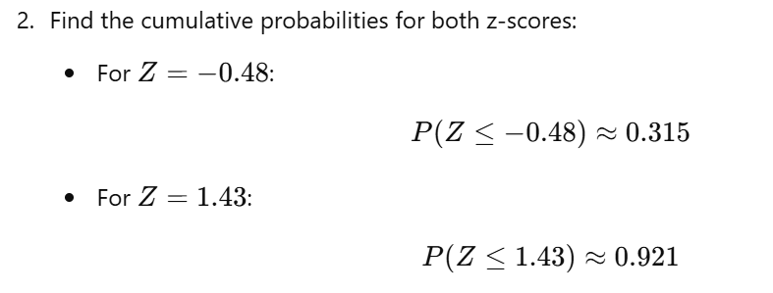

Slide 8


Slide 9
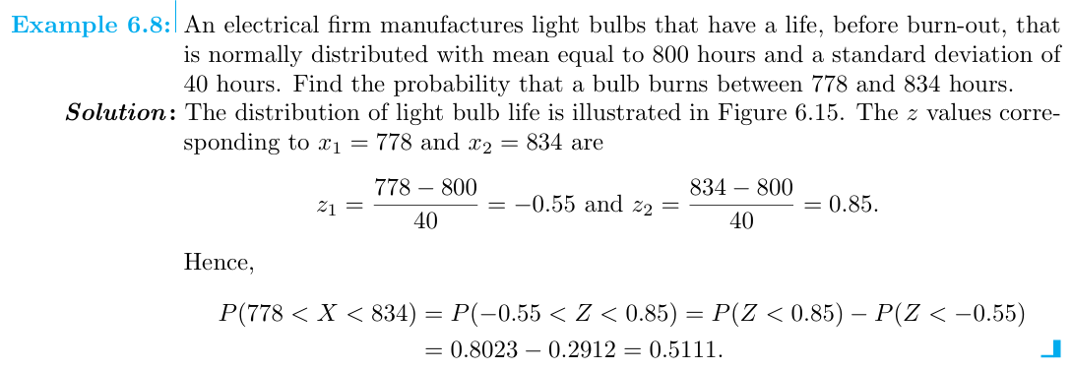

Slide 10
A binomial random variable can also be approximated by using normal random variable methods discussed above. This approximation can take place as long as:
The population size must be at least 10 times the sample size.

Slide 11


Slide 12



Slide 13
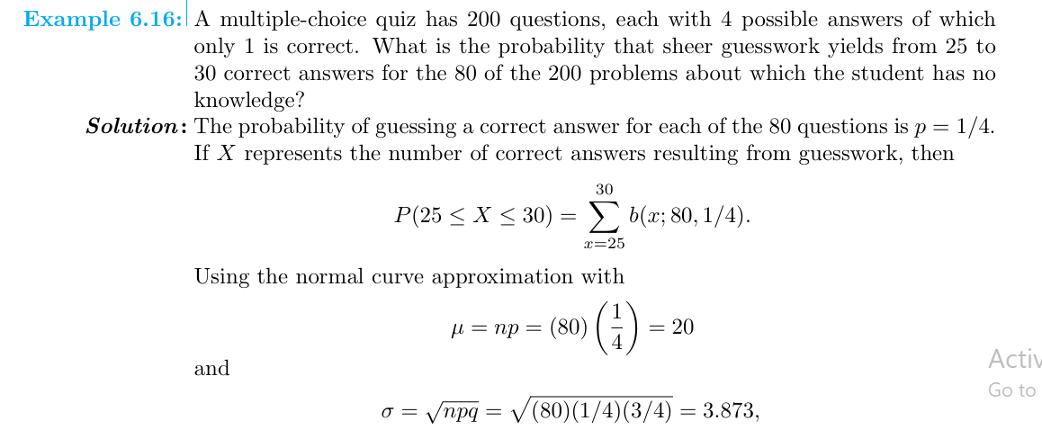

Slide 14
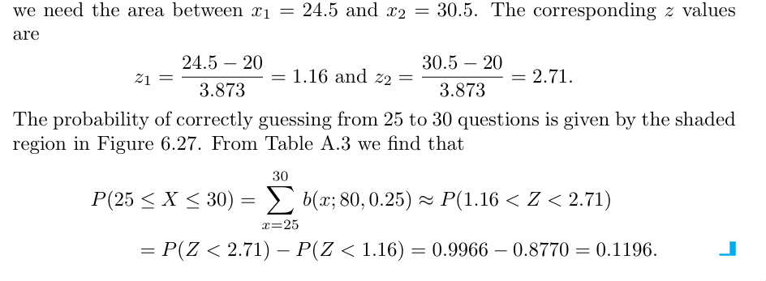

Slide 15


Slide 16
